Slide 1
Where to Open a New Coffee Shop in Toronto?
Data Science Capstone Project

Slide 2
Introduction
International coffee chain is looking to expand to Canada and wants to open its first location in Toronto.
It is looking for an area that fits the following criteria:
Large customer base: Densely populated area with many residents, offices and schools
Underdeveloped Coffee Scene: Not many existing coffee shop in area

Slide 3
Data
The analysis was performed by integrating the following data sets:
Neighbourhood information for the City of Toronto (https://en.wikipedia.org/wiki/List_of_postal_codes_of_Canada:_M )
Venue-related information for the City of Toronto obtained from Foursquare
Main Packages/Concepts Used
Pandas
Folium
K-means

Slide 4
Methodology
Data from both sources was extracted and combined into 1 data frame which showed the different venues found in each Toronto neighbourhood
A machine learning model (k-means) used to classify all Toronto neighbourhoods into similar clusters
The best areas were those who did not have a café or a coffee shop within a 1-kilometer radius
These areas were plotted on a map of Toronto

Slide 5
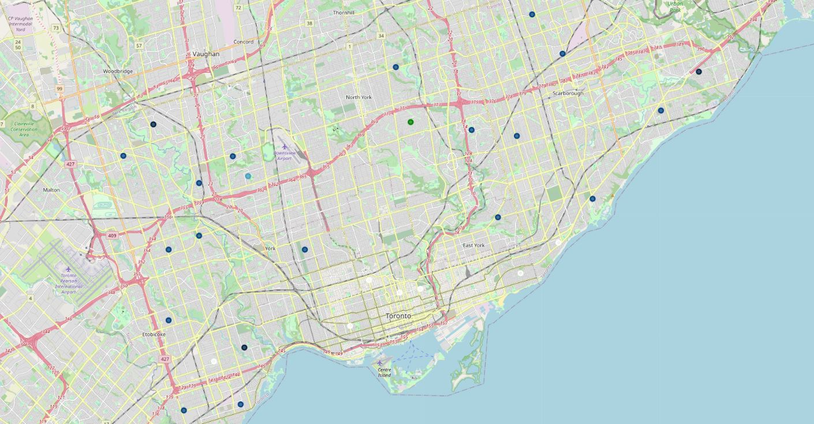
Results
Data from both sources was extracted and combined into 1 data frame

Slide 6
Discussion
Results show the city’s west and east ends do not have many coffee houses
There are more underserved areas in the city’s west end – especially in the north west.
The area inside the square should be analyzed further to determine the best opening location
If it acts quickly, the chain could become the dominant coffee brand in the area
START HERE!

Slide 7
Conclusion
The city’s northwest area has been identified as being underserved by other coffee brands and as the best area in which to launch
The company should conduct further analysis to determine the best location for its first coffee shop in this large area by examining data such as :
Household income
Foot traffic
Food/drink preferences via a survey of area residents

